Slide 1


Online
Scholarship
Review Training
Kari Hooker-Leep, Executive Director
Candi Wiemers, Programs & Marketing Coordinator

Slide 2


GIPS Foundation Online Scholarship Review
Our Mission
The GIPS Foundation builds strong partnerships with the district and community stakeholders, responsibly manages and grows charitable assets, and inspires the power of community to invest in access, equity and opportunity for all GIPS students.

Slide 3

GIPS Foundation Online Scholarship Review
One Application for 200+ Scholarships
$671,000 scholarship money available
Scholarships range from $250 - $260,000
Scholarships available for ALL degrees and majors
60% of 2024 GISH Seniors who completed an application were awarded scholarships

Slide 4
GIPS Foundation Online Scholarship Review
188 Total Submitted Applications
115 GISH, 66 Non-GISH, 7 in College
Applications from: Grand Island Senior High, Grand Island Northwest, Grand Island Central Catholic, Adams Central, Aurora, Central Valley, Doniphan-Trumbull, Fullerton, Hastings, High Plains, Ravenna, St Cecilia, Wood River, York
Notes:
We will use the email in the application to communicate during the process

Slide 5
GIPS Foundation Online Scholarship Review
90 Review Volunteers in 2025
Our reviewers are divided up into review groups
Each group is unique and assigned to review specific scholarships
GIPS Foundation has 27 review groups
Independent online review
Blind review process

Slide 6

GIPS Foundation Online Scholarship Review
How to start?
Log into your reviewer account Username: your full email address Password: review

Slide 7
GIPS Foundation Online Scholarship Review
Review Webpage
Link to Application
Scholarship Training Booklet
Scholarship Terms & Videos
Reviewer Training Zoom videos
Frequently Asked Questions
https://gipsfoundation.org/what-we-do/scholarships/scholarship-review.html

Slide 8

Reviewer Lists Overview

Slide 9
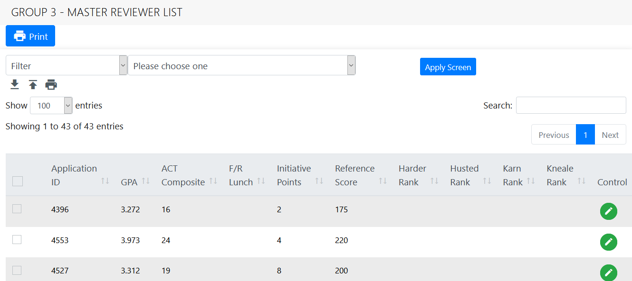
GIPS Foundation Online Scholarship Review
Master Reviewer List
The first screen you see when you log into the system
Do NOT review applications from the Master Reviewer List

Slide 10
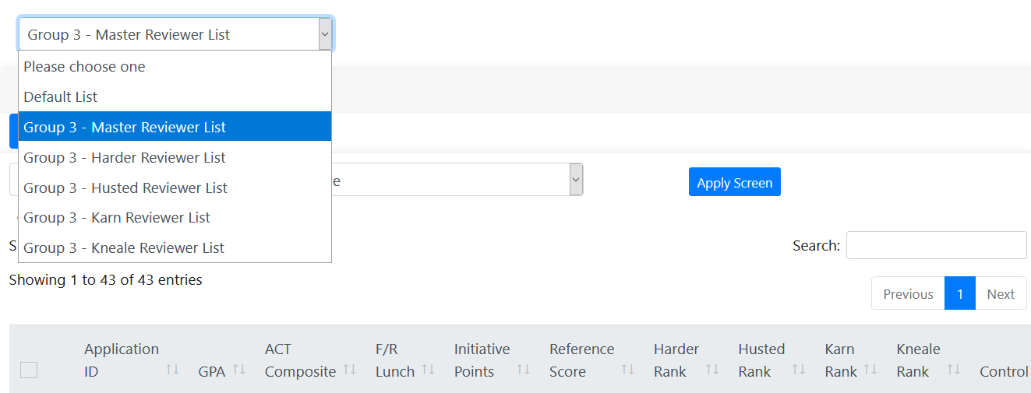
GIPS Foundation Online Scholarship Review
Scholarship Reviewers Lists
All scholarships assigned to your review team have a list
Select list from menu to view eligible applications

Slide 11
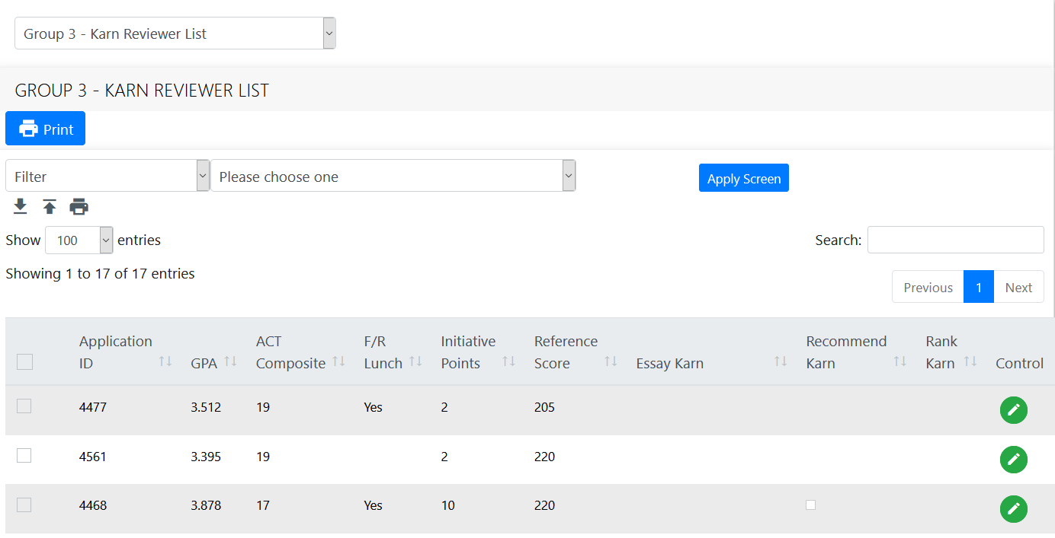
GIPS Foundation Online Scholarship Review
Scholarship Reviewers Lists
Each reviewer list has the scholarship filter embedded
Reviewers do not select filters

Slide 12
GIPS Foundation Online Scholarship Review
Scholarship Reviewers Lists
Each line is a student who has submitted an application
Lists are like spreadsheets
Columns can be sorted
Lists display recommendation and ranking progress

Slide 13
GIPS Foundation Online Scholarship Review
?
Reviewer Lists
Questions?
Application example
?
?

Slide 14
Filters Overview

Slide 15
GIPS Foundation Online Scholarship Review
How are eligible applications selected?
Each scholarship has unique eligibility qualifications Example: GPA, specific major or college
Eligibility qualifications are listed in the scholarship guidelines
Guidelines for your review group included in handouts
These qualifications are programmed into the application as filters
Each scholarship has an application filter

Slide 16

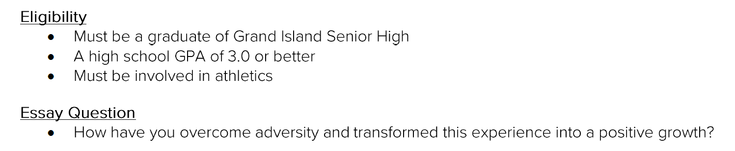
GIPS Foundation Online Scholarship Review
Example:
Eligibility qualifications for the Emilio DeLeon Memorial Scholarship

Slide 17
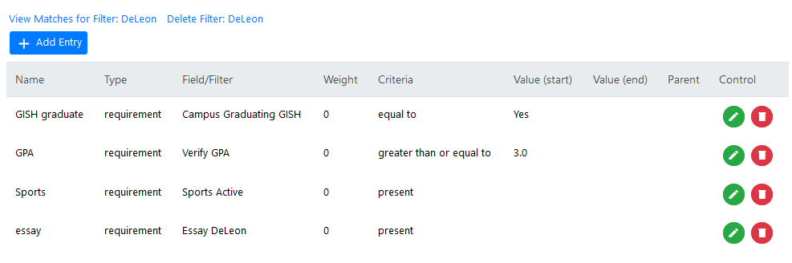
GIPS Foundation Online Scholarship Review

Slide 18
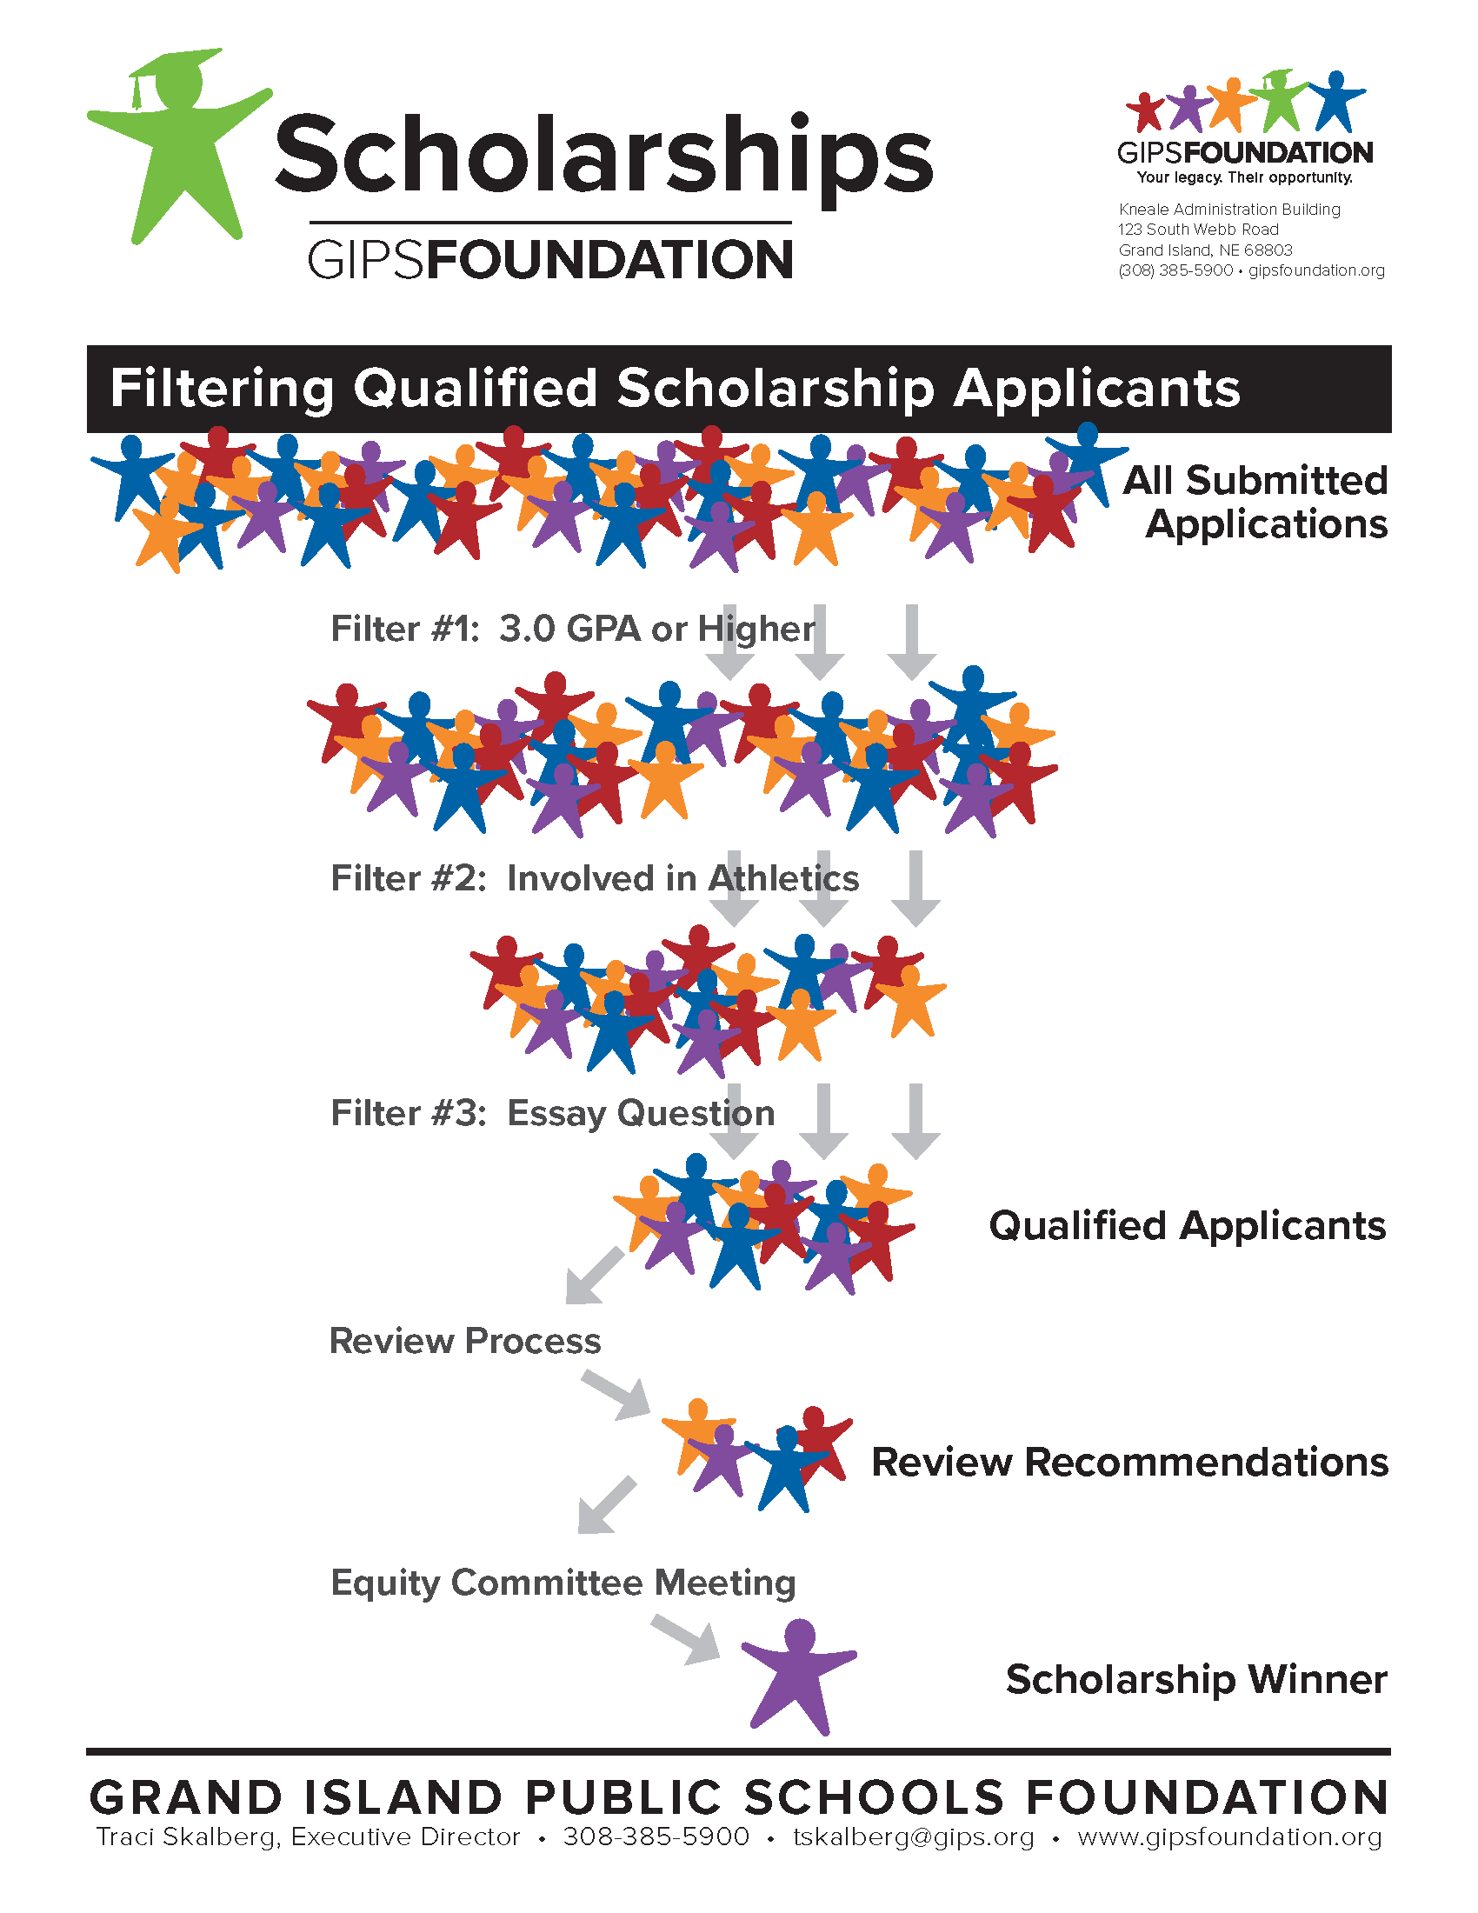
GIPS Foundation Online Scholarship Review
Filter Process:
All Submitted Applications
Filter is applied
Each qualification in the filter eliminates unqualified applications
Qualified Applicants
Reviewers only see qualified applications

Slide 19
GIPS Foundation Online Scholarship Review
Filter Process:
Review Process
Qualified applications are reviewed, recommended and ranked
Allocation Committee Meeting
Scholarship Winner

Slide 20
GIPS Foundation Online Scholarship Review
Do I need to select a filter?
No
Each reviewer list has the scholarship filter embedded
The correct filter is automatically applied

Slide 21
GIPS Foundation Online Scholarship Review
?
Filters
Questions?
?
?

Slide 22
Sorting Overview

Slide 23
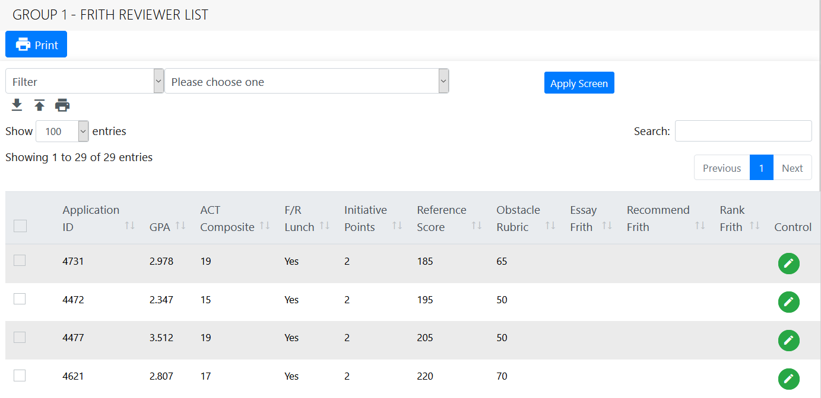
GIPS Foundation Online Scholarship Review
How do I sort applications?
The filtered list is similar to a spreadsheet
Applications can be sorted by column values

Slide 24

GIPS Foundation Online Scholarship Review
How do I sort applications?
Click on the arrows of the column you want to sort by
Columns can be sorted by ascending or descending values

Slide 25
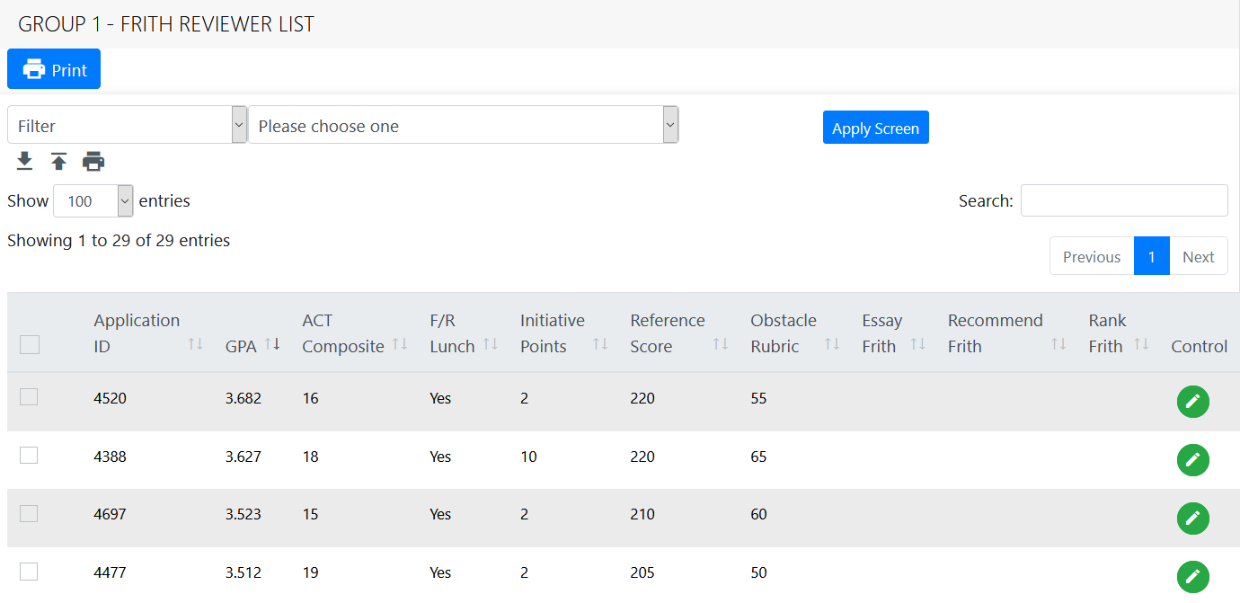
GIPS Foundation Online Scholarship Review
How do I sort applications?
List is sorted by GPA

Slide 26

GIPS Foundation Online Scholarship Review
How do I sort applications?
List is sorted by ACT

Slide 27
GIPS Foundation Online Scholarship Review
How do I sort applications?
List is sorted by Free or Reduced Lunch

Slide 28
GIPS Foundation Online Scholarship Review
Why would I want to sort applications?
Some scholarship eligibility guidelines include GPA or ACT
It can be helpful to sort the applications first, then open for review
Sorting is very useful for Recommending and Ranking

Slide 29
GIPS Foundation Online Scholarship Review
?
Sorting
Questions?
?
?

Slide 30
Navigation Menu Overview

Slide 31
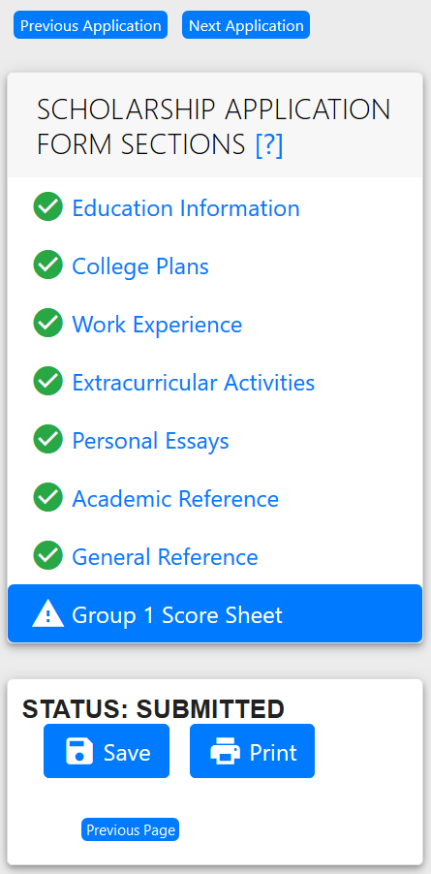
GIPS Foundation Online Scholarship Review
Previous Application To view the same document in another application
Opens the same document in the application listed above the current application in the reviewer list

Slide 32
GIPS Foundation Online Scholarship Review
Next Application To view the same document in another application
Opens the same document in the application listed below the current application in the reviewer list

Slide 33
GIPS Foundation Online Scholarship Review
Education Information Scholarship Application Form Selections
Elementary, middle, high schools years attended
GPA
ACT scores

Slide 34
GIPS Foundation Online Scholarship Review
College Plans Scholarship Application Form Selections
college/university acceptance status if the college/university is in Nebraska
general major – specific major
general minor – specific minor
degree working towards

Slide 35
GIPS Foundation Online Scholarship Review
Work Experience Scholarship Application Form Selections
work history start/end dates
hours
internships

Slide 36
GIPS Foundation Online Scholarship Review
Extracurricular Activities Scholarship Application Form Selections
school activities
school sports
community activities/awards
leadership essay
volunteer essay

Slide 37
GIPS Foundation Online Scholarship Review
Personal Essays Scholarship Application Form Selections
personal narrative
career goals
financial plan

Slide 38
GIPS Foundation Online Scholarship Review
References Scholarship Application Form Selections
Academic Reference
a high school teacher who personally taught the applicant; scores; strengths/weakness
character statement
General Reference
a teacher, coach, counselor, supervisor, or anyone not related to the student
Same information as academic reference.

Slide 39
GIPS Foundation Online Scholarship Review
Score Sheet Scholarship Application Form Selections
One score sheet per application
Reviewer scores and comments are not viewable by other reviewers
General Comments field is used to create “notes” to yourself about the application. This will speed up the review process.

Slide 40
GIPS Foundation Online Scholarship Review
?
Navigation Menu
Questions?
Application example
?
?

Slide 41
Special Essays Overview

Slide 42
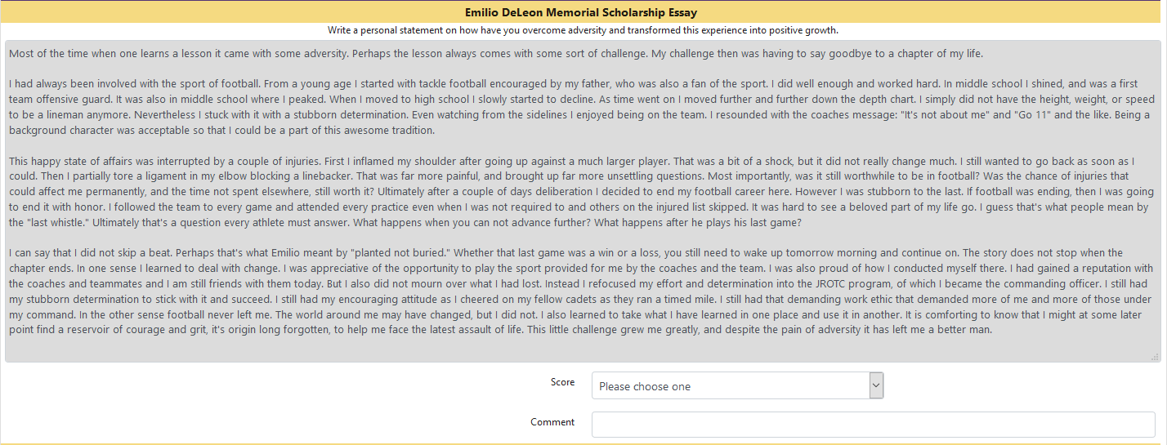
GIPS Foundation Online Scholarship Review
Score Sheet
Several scholarships require special essays
They are listed on the score sheet

Slide 43
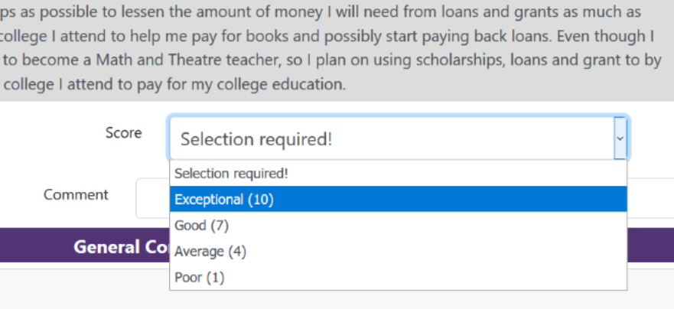
GIPS Foundation Online Scholarship Review
Essay Score
After reading the essay select a score
Use comment field for quick notes

Slide 44
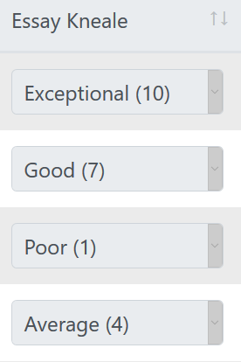
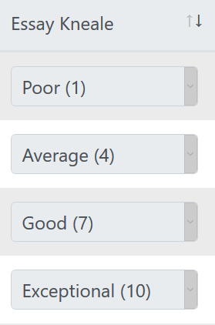
GIPS Foundation Online Scholarship Review
Sorting Essay Scores
From the scholarship reviewer list, click column to sort
unsorted
sorted

Slide 45
GIPS Foundation Online Scholarship Review
?
Special Essays
Questions?
Application example
?
?

Slide 46
Recommend and Rank Overview

Slide 47
GIPS Foundation Online Scholarship Review
How do I recommend applications?
Recommending applications is a scholarship selection tool
Review eligible applications first using the guideline
After you review an application and decide you want to recommend it for the scholarship, click on the box next to the scholarship name at the bottom of the score sheet

Slide 48
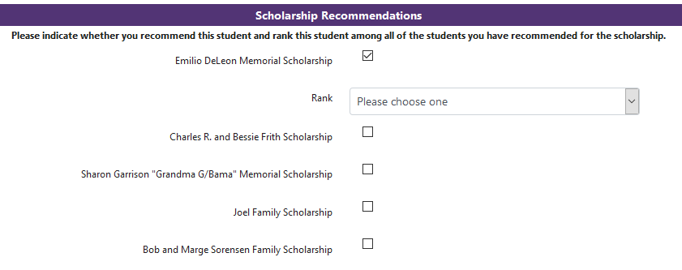
GIPS Foundation Online Scholarship Review
Recommend
The Rank field appears once you save the recommendation
Do not Rank the application at this time

Slide 49

GIPS Foundation Online Scholarship Review
Recommend – Review - Repeat
Continue to review other applications in the reviewer list
If you determine another application should be considered for the scholarship, click the recommendation field
Repeat until all applications have been considered

Slide 50
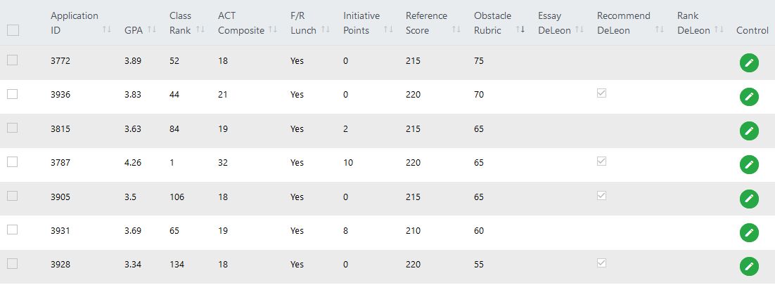
GIPS Foundation Online Scholarship Review
Recommend
Recommendations appear on the Scholarship Reviewer List

Slide 51
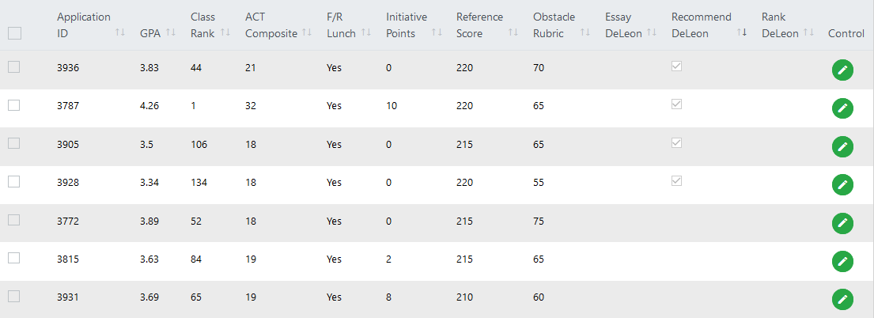
GIPS Foundation Online Scholarship Review
Recommend
Click on the column to sort recommendations to the top

Slide 52
GIPS Foundation Online Scholarship Review
How do I rank applications?
Open the recommended applications to review and compare applications to each other

Slide 53
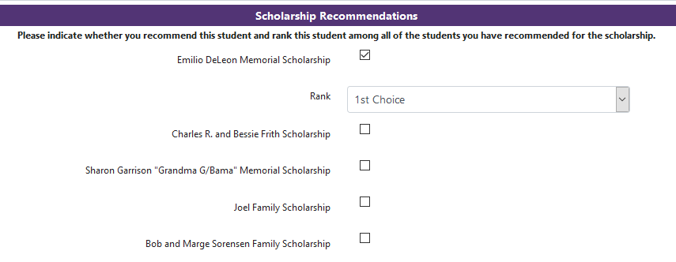
GIPS Foundation Online Scholarship Review
Rank
Select the application you determine to be the best fit for the scholarship and click on 1st Choice for a rank

Slide 54
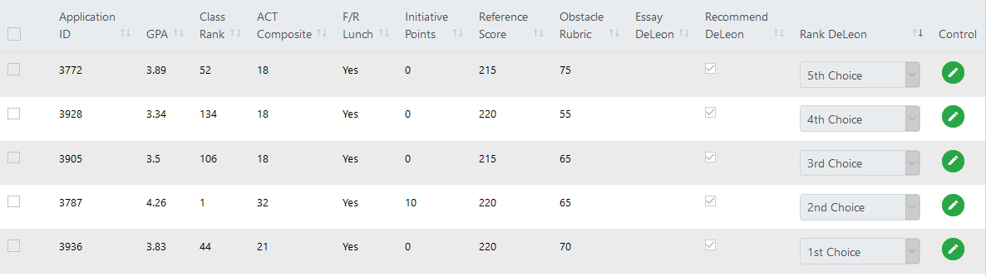
GIPS Foundation Online Scholarship Review
Rank
Continue ranking applications until all rank choices are used
View Scholarship Reviewer List to confirm selections

Slide 55
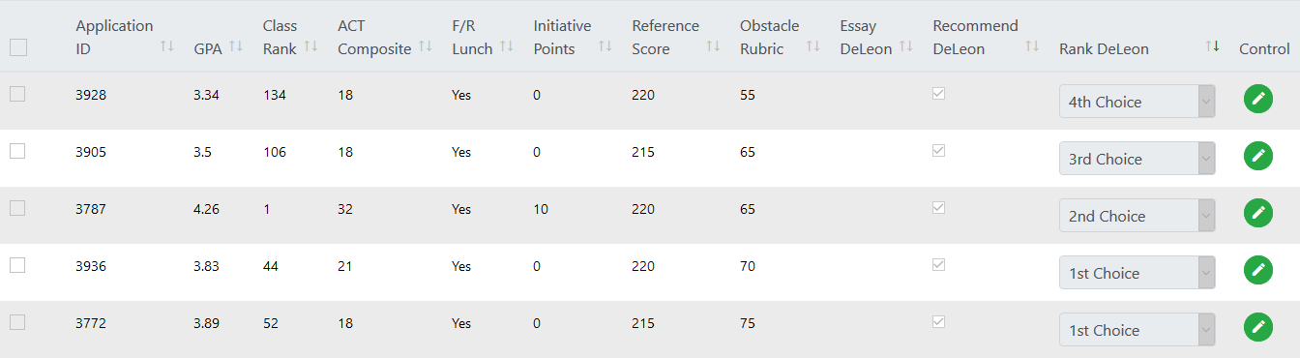
GIPS Foundation Online Scholarship Review
Rank
DO NOT use a ranking more than once per scholarship

Slide 56
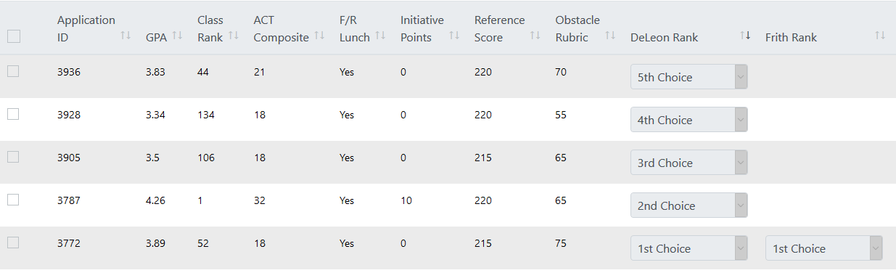
GIPS Foundation Online Scholarship Review
Rank
However, you CAN use a ranking more than once per application for different scholarships

Slide 57

GIPS Foundation Online Scholarship Review
Rank – Repeat – Email when done
Continue the recommend and rank process until all scholarships assigned to your review group are completed
Contact cwiemers@gips.org when you are satisfied with your rankings
The ranking selections for the entire review group are combined and used at the Allocation Committee Meeting to select scholarship finalists

Slide 58
GIPS Foundation Online Scholarship Review
?
Recommend and Rank
Questions?
Application example
?
?

Slide 59
Merit and Obstacle Rubrics

Slide 60
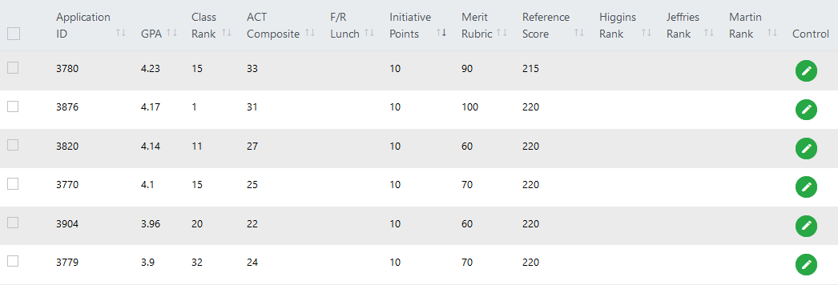
GIPS Foundation Online Scholarship Review
Merit Rubric
A numeric value associated with high school performance

Slide 61
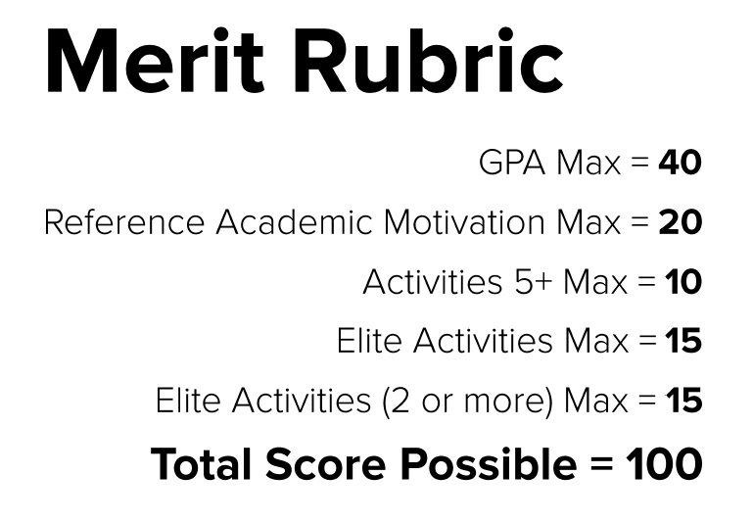
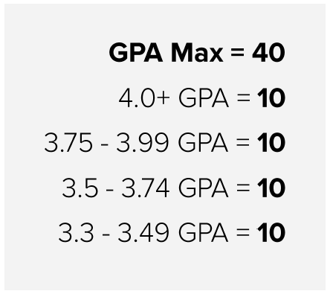
GIPS Foundation Online Scholarship Review

Slide 62
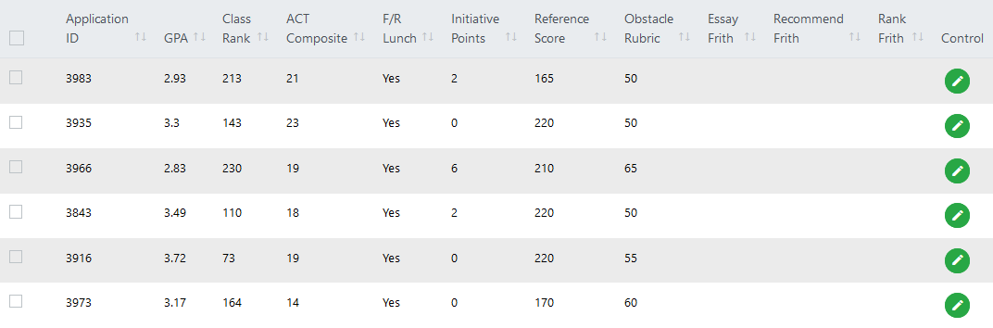
GIPS Foundation Online Scholarship Review
Obstacle Rubric
A numeric value measuring different obstacles

Slide 63
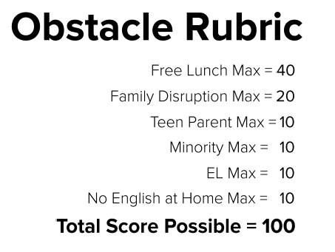
GIPS Foundation Online Scholarship Review

Slide 64
What happens after the review?

Slide 65
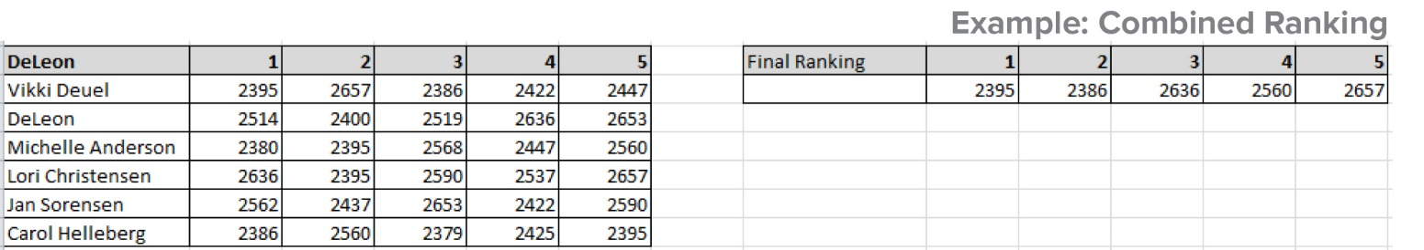
GIPS Foundation Online Scholarship Review
Allocation Committee
Reviewer Team rankings are combined
Team rankings are used at the Allocation Committee meeting
Still a blind review process
Committee ensures a few students do not receive the majority of the scholarship offers
Scholarship offer list created

Slide 66
GIPS Foundation Online Scholarship Review
Offer Letters
Scholarship offer letters are mailed to students
Students determine if they will accept/decline offers
Offer letters signed and returned to GIPS Foundation
If offer is declined, second offer letter sent to alternate

Slide 67
GIPS Foundation Online Scholarship Review
Celebrate!
Multiple scholarship receptions
Complete scholarship award list published in the paper
Social media posts all summer featuring winners and donors

Slide 68
GIPS Foundation Online Scholarship Review
Thank you!
Our reviewers and donors make the GIPS Foundation scholarship program possible

